Slide 1
Portfolio Assessment
Lachlan Greve
CCC-012117

Slide 2
Overview
This presentation will review:
Design Process & Decisions
Portfolio Website and Features
Development & Build Process

Slide 3
Design process & Objectives

Slide 4
Objective
Build a portfolio that demonstrates my skills and abilities, particularly in web design
Clean & functional styling that is easy to understand and navigate
Responsive content that is dynamic and adjusts to the user’s viewport
An accessible and secure website that follows W3C standards
4 Individual HTML Pages
Design Process & Objectives

Slide 5
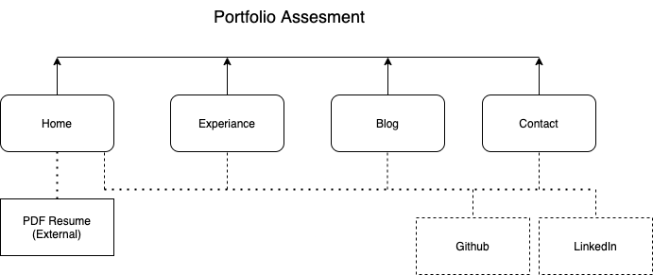
SITEMAP
Design Process & Objectives

Slide 6
PLANNING:
Planning:
Wireframing and research into how write HTML and CSS
Time Allocation:
Planning my time to develop the portfolio and setting deadlines in my calendar
Source Control:
A Github remote repository for source control and deployment of the portfolio
Design Process & Objectives

Slide 7
Portfolio Website and Features

Slide 8
Tech STACK
HTML5
CSS3
Deployed on Github through Github Pages
Source Control on Github
Portfolio Website and Features

Slide 9
HTML/CSS Components
Navigation Bar
Footer
Header
Sections
Articles
Images
Figures
Anchors
Body
Main
Div
Portfolio Website and Features

Slide 10
UNIVERSIAL Components
Navigation Bar & Header:
The four pages of my portfolio are accessible through a common Nav Bar.
The current page is colored red (Home). On hover the background will change to red (Experience)
The header of the page is my name, with an anchor to the top of the page.
Portfolio Website and Features

Slide 11
UNIVERSIAL Components
Footer:
The footer is displayed at the bottom of each page and contains clickable links to get in contact with me.
Includes a Back to Top anchor the is linked to the header at the top of the page.
Portfolio Website and Features

Slide 12
Website Styling
Background:
#f1f1f1f1
Sections:
#ffffff
Content:
#333333
Highlights:
#FF0000
Font Style: Roboto
Text:
#000000
Portfolio Website and Features

Slide 13
Development & Build Process

Slide 14
HOME PAGE - DESIGN
Image of myself, my partner and my cats.
Introduction to my portfolio.
An anchor link to download a current version of my resume.
Development & Build Process
Development & Build Process

Slide 15
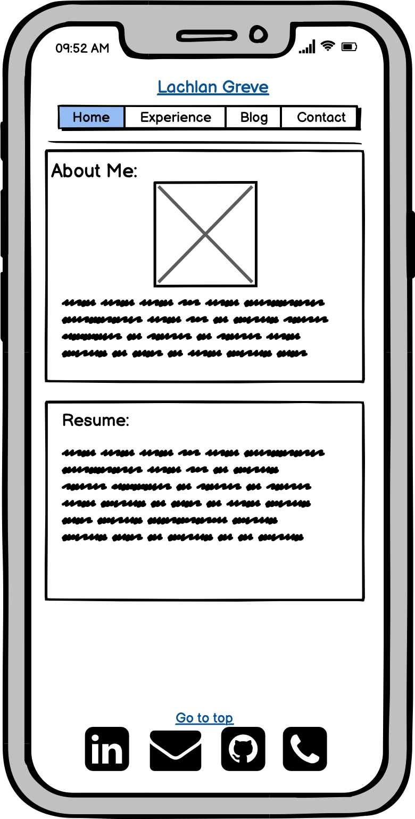
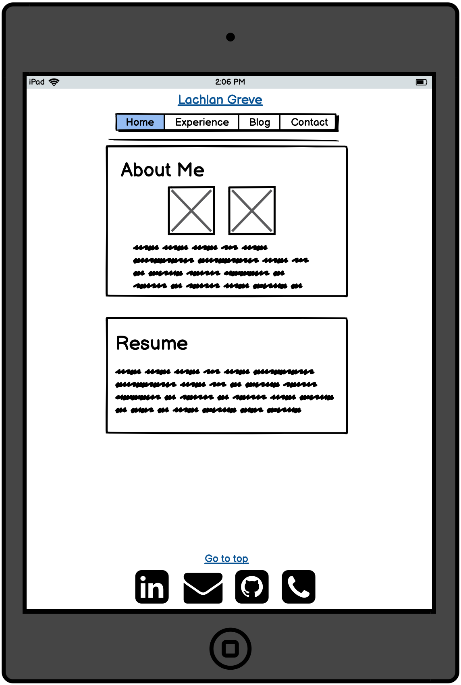
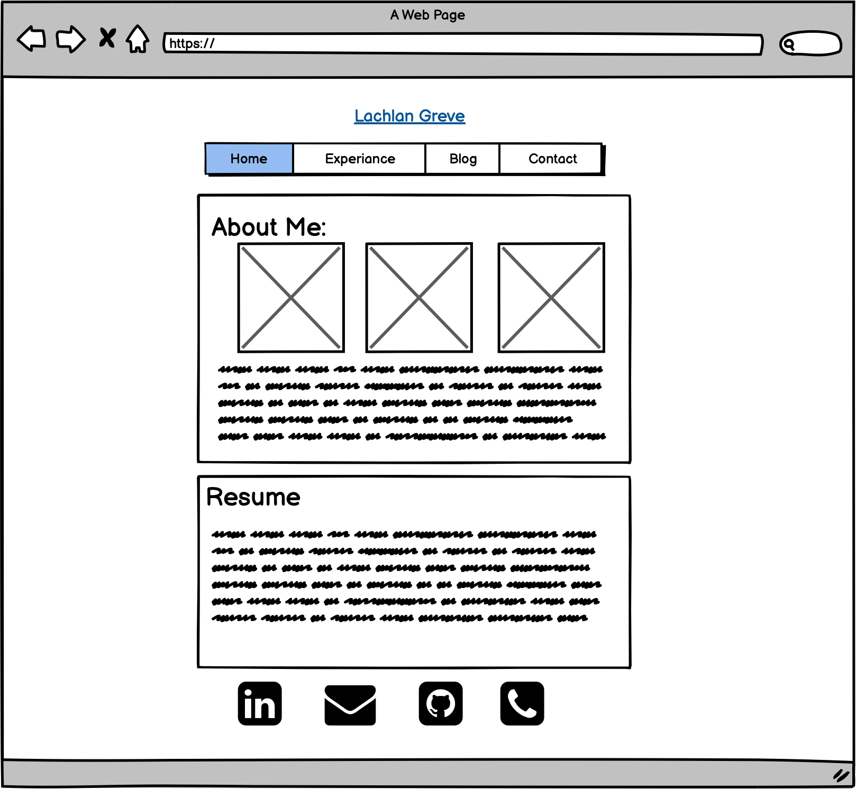
Home PAGE - WIREFRAMING
Audience Engagement:
Images displayed on screen are adjusted and resized depending on the size of the screen
Sections of content a segmented with a separate style ‘card’
Nav bar hover effect and highlight of current selection
Back to top link
Development & Build Process

Slide 16
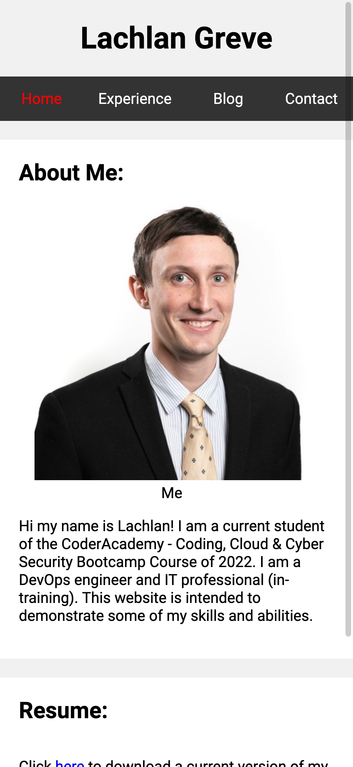
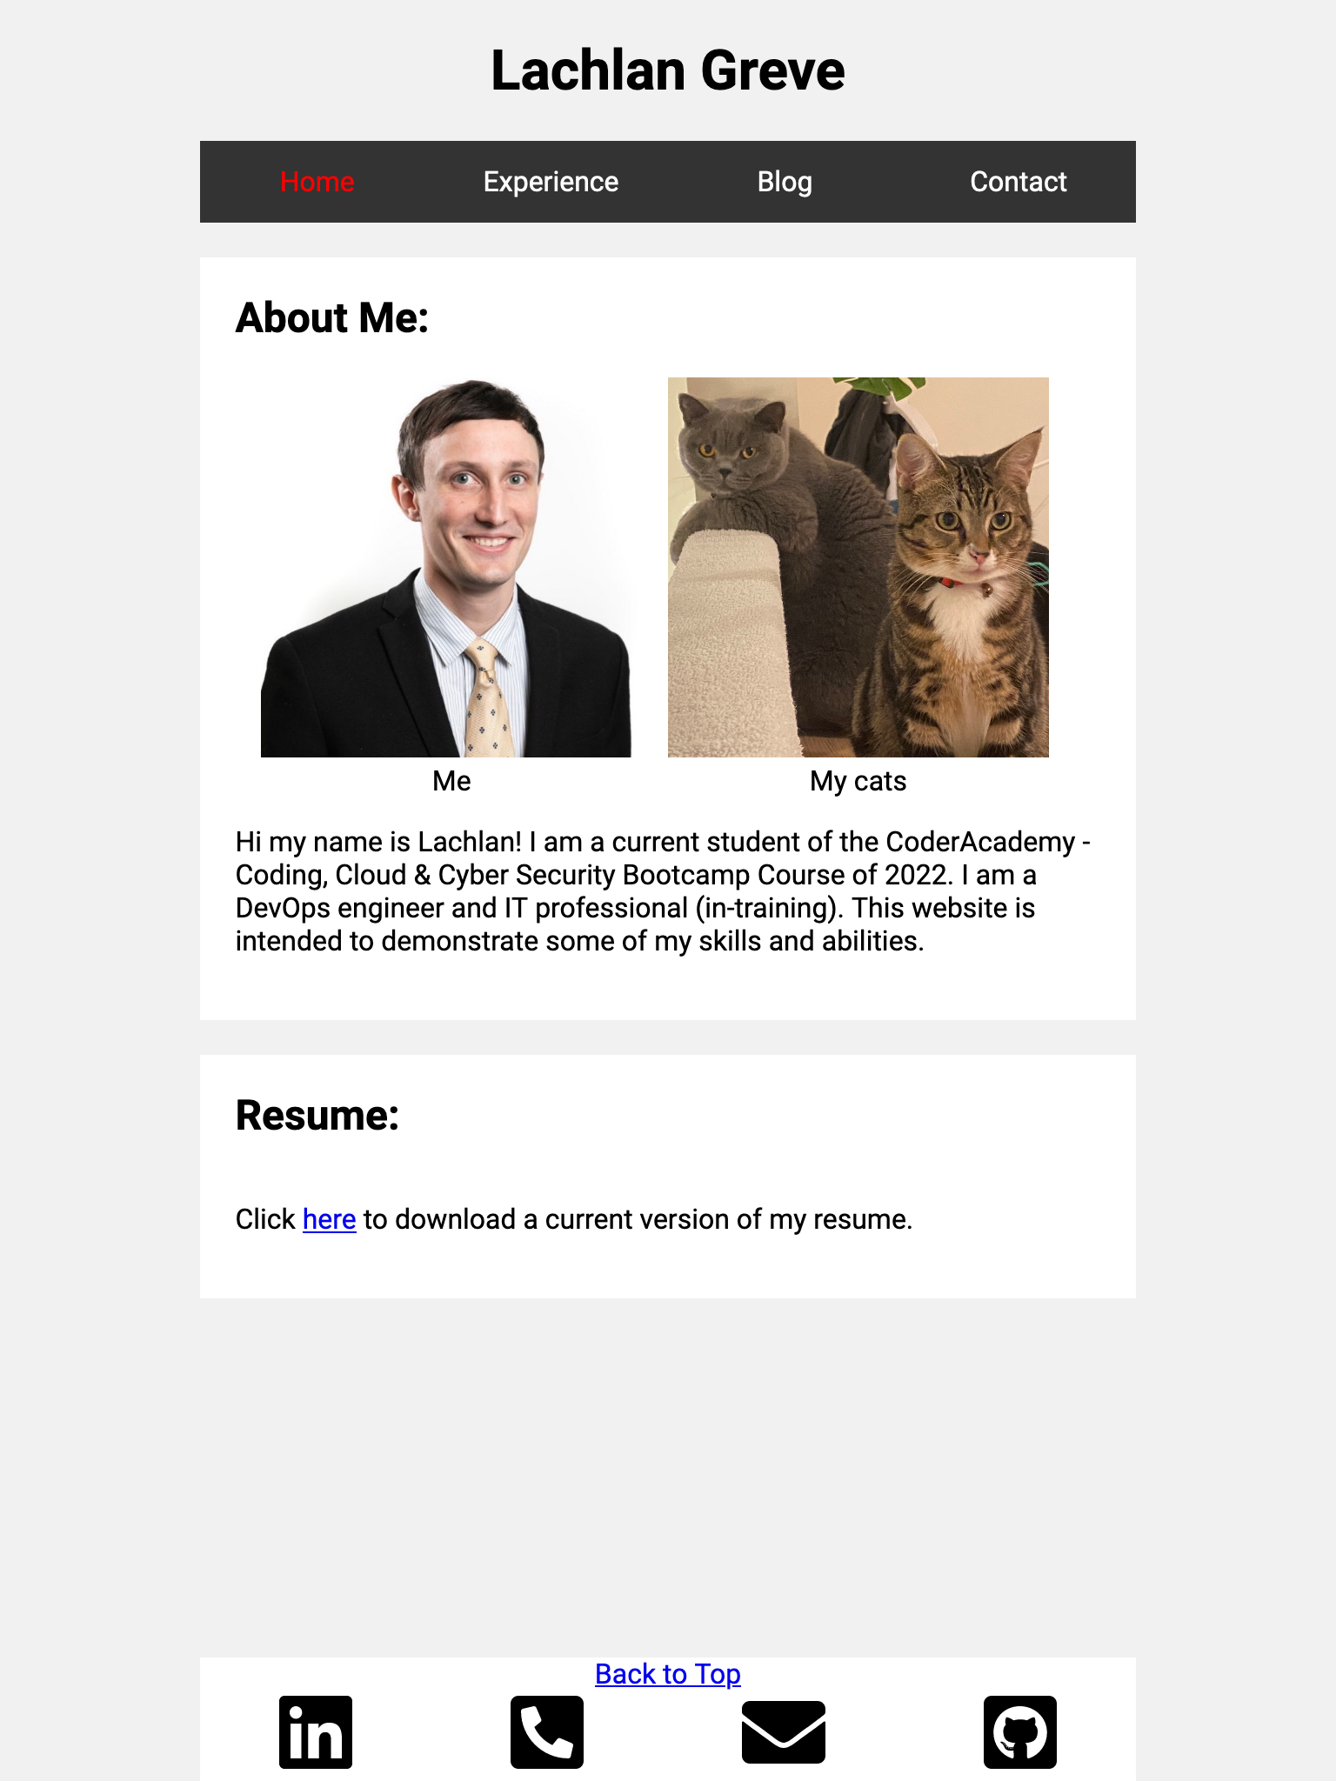
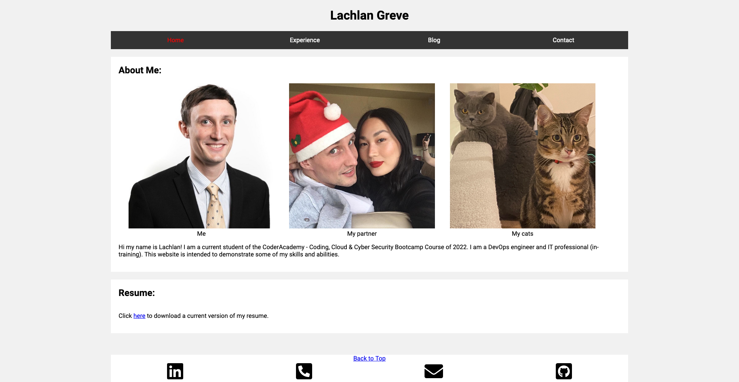
HOME PAGE - FINAL DESIGN
Development & Build Process

Slide 17
EXPERIENCE PAGE - DESIGN
A timeline of my professional qualification and work history
4 Individual sections of content
Responsive design that separates sections of information and presents it in an interesting way
Development & Build Process

Slide 18
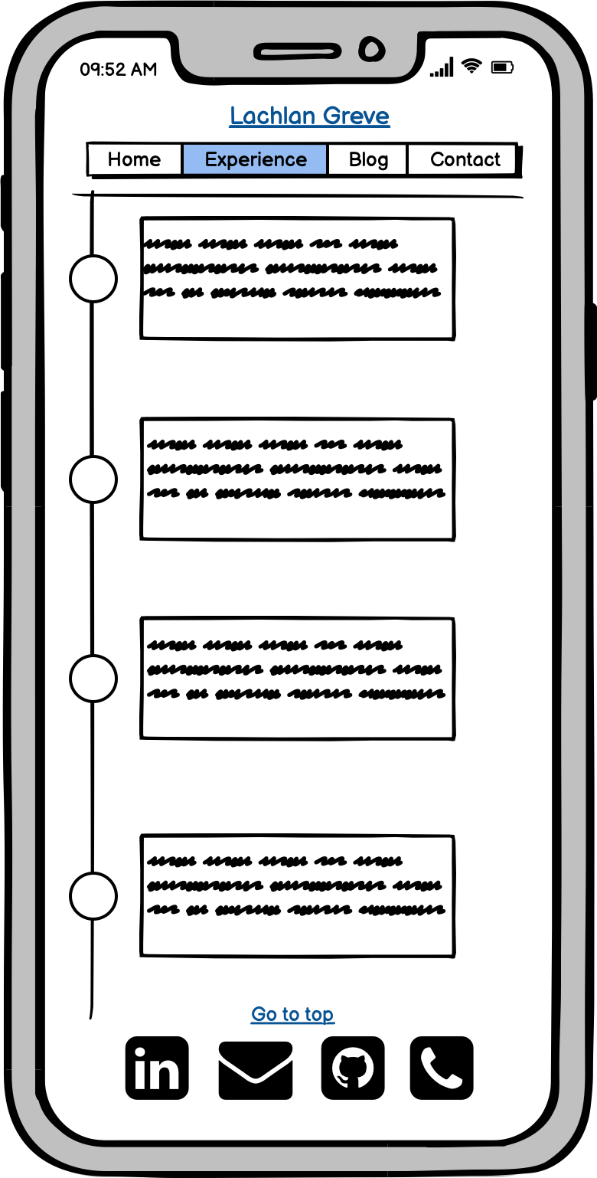
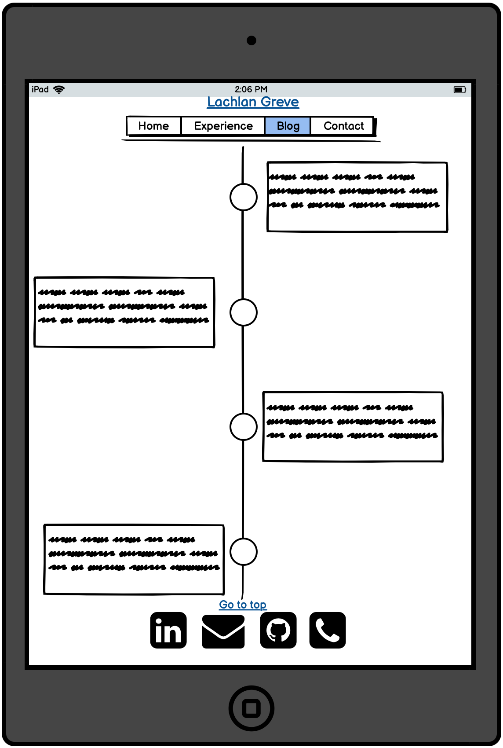
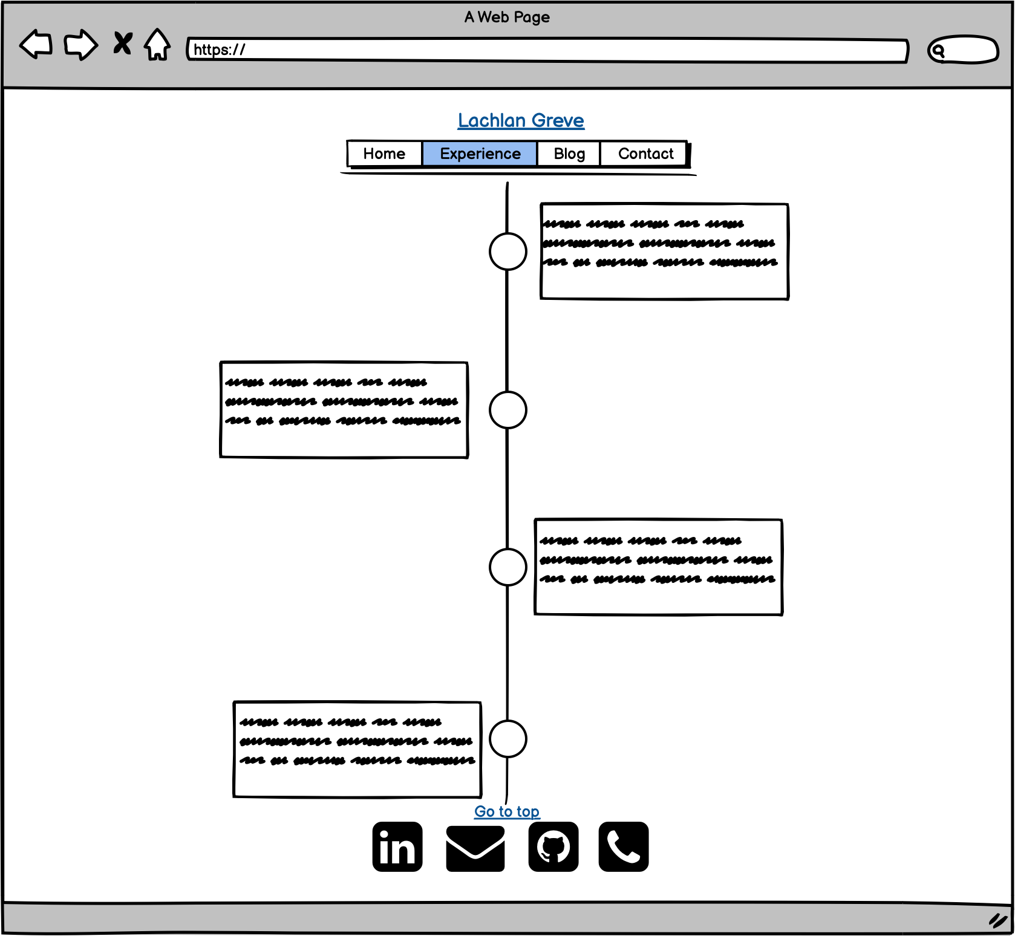
Experience PAGE - WIREFRAMING
Audience Engagement:
Content is displayed on an interactive timeline that staggers blocks of text and resizes depending on the size of the screen.
Nav bar hover effect and highlight of current selection
Development & Build Process

Slide 19
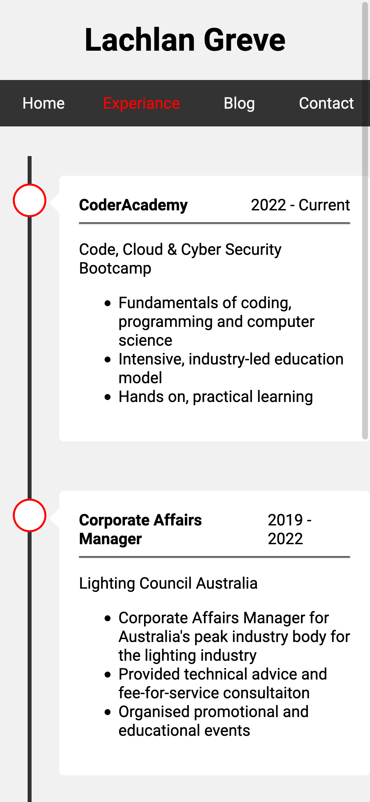
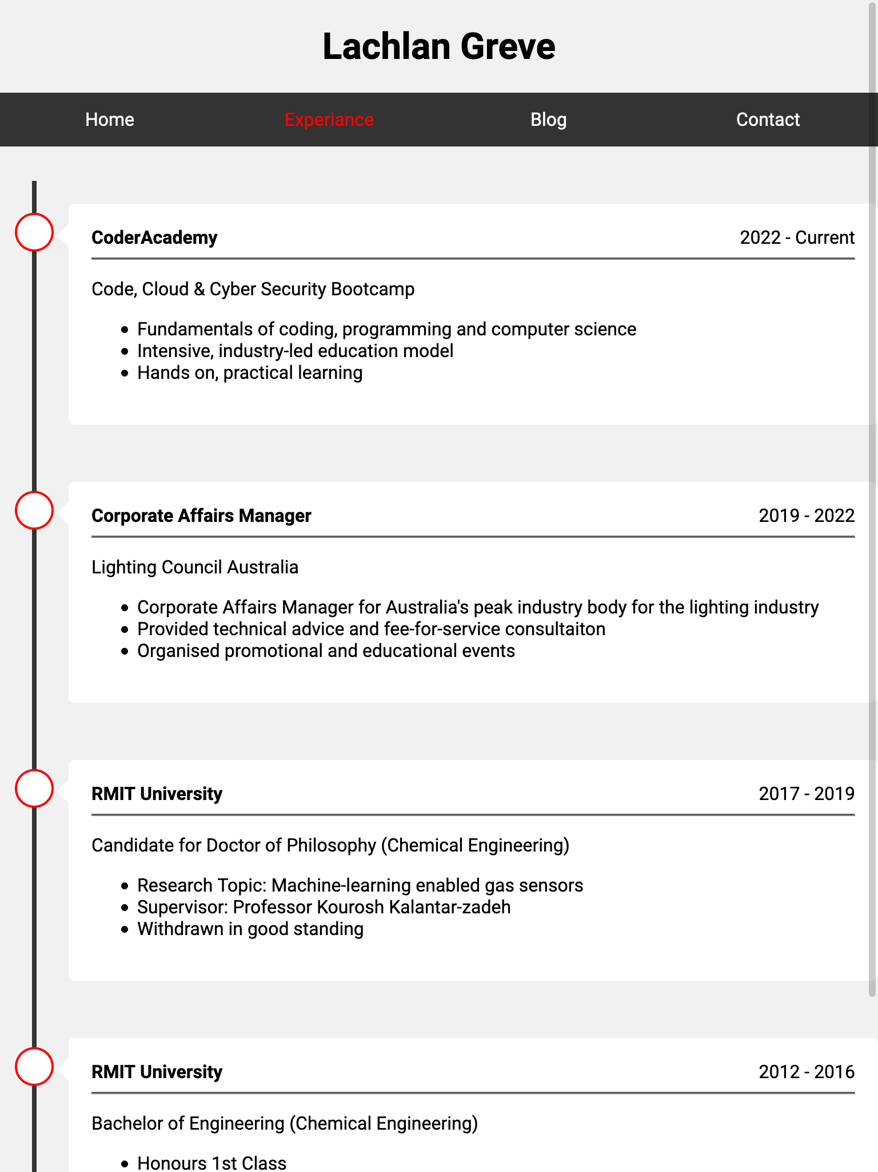
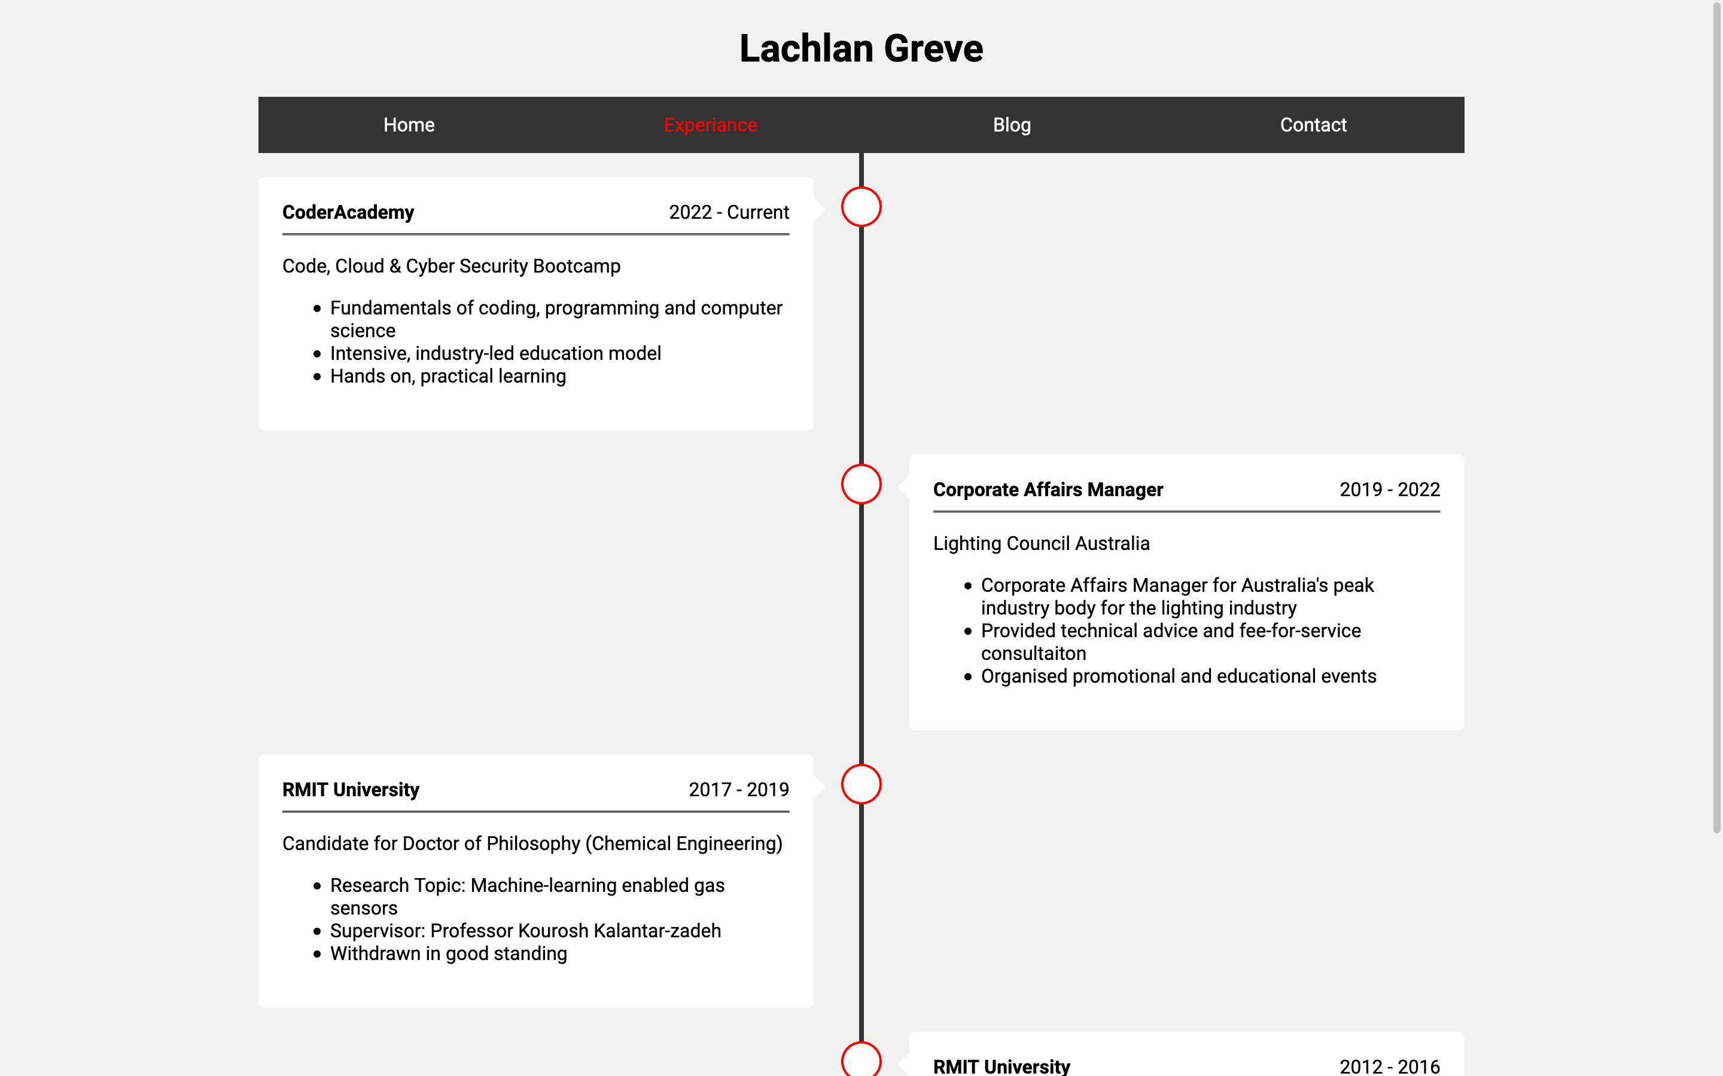
Experience PAGE FINAL DESIGN
Development & Build Process

Slide 20
BLOG PAGE - DESIGN
A list of recent posts sorted by date posted.
Anchor links that will take the user to the posts when clicked.
At least 5 Blog posts with images
Development & Build Process

Slide 21
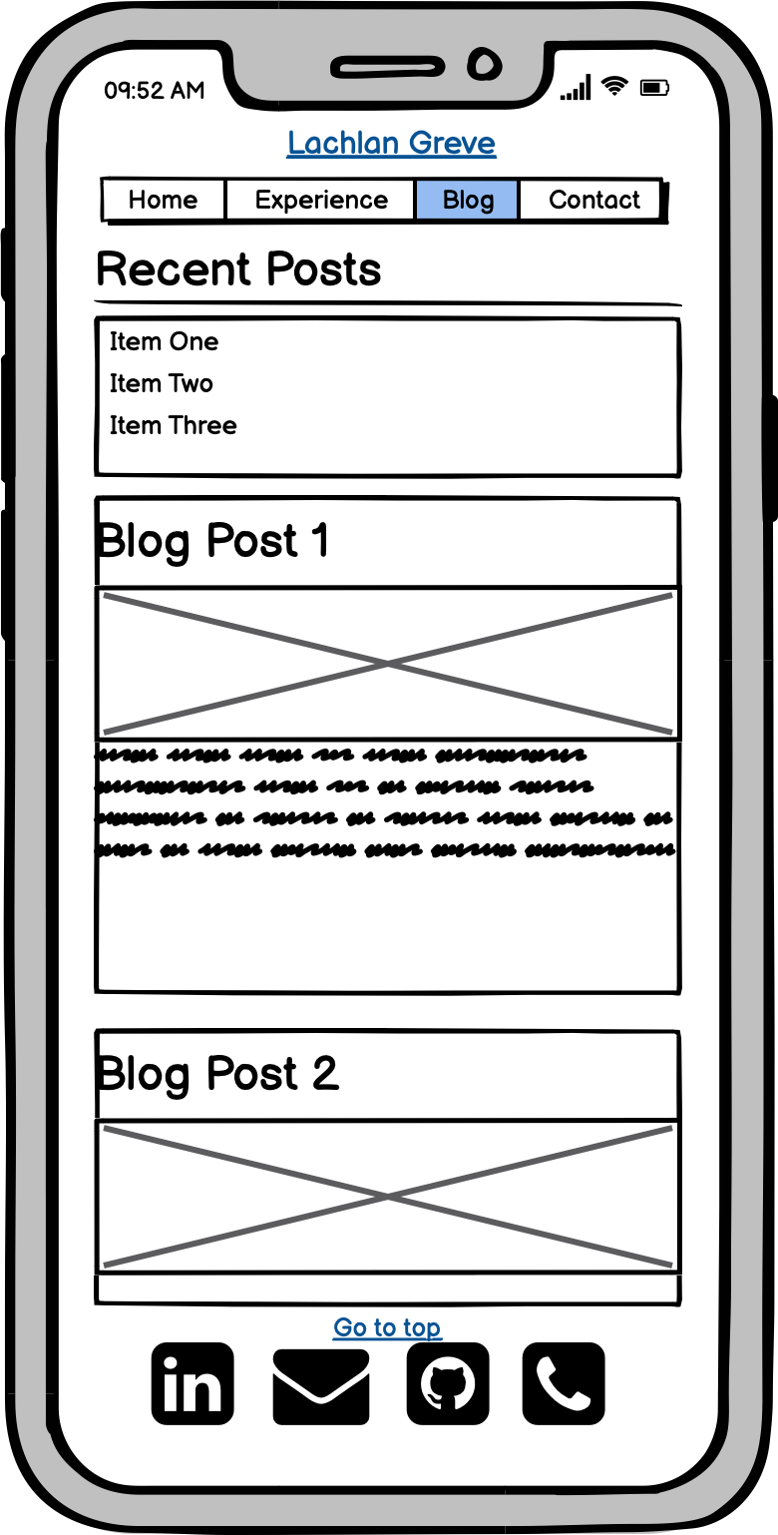
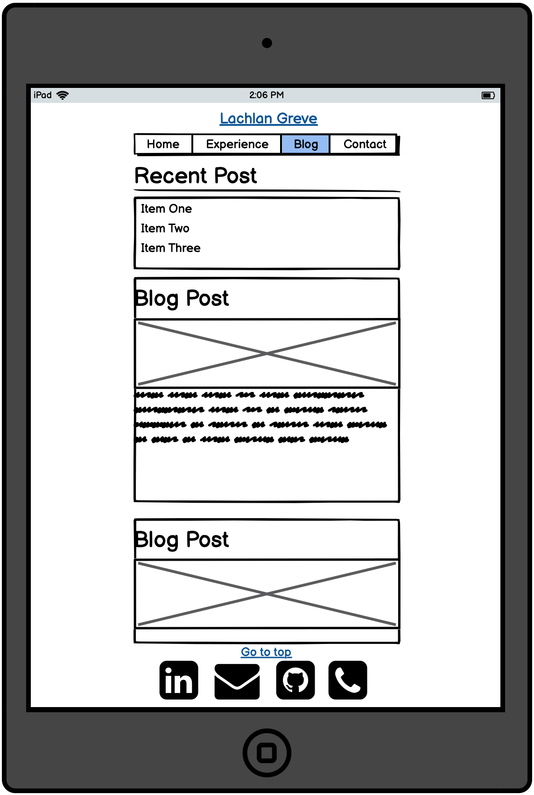
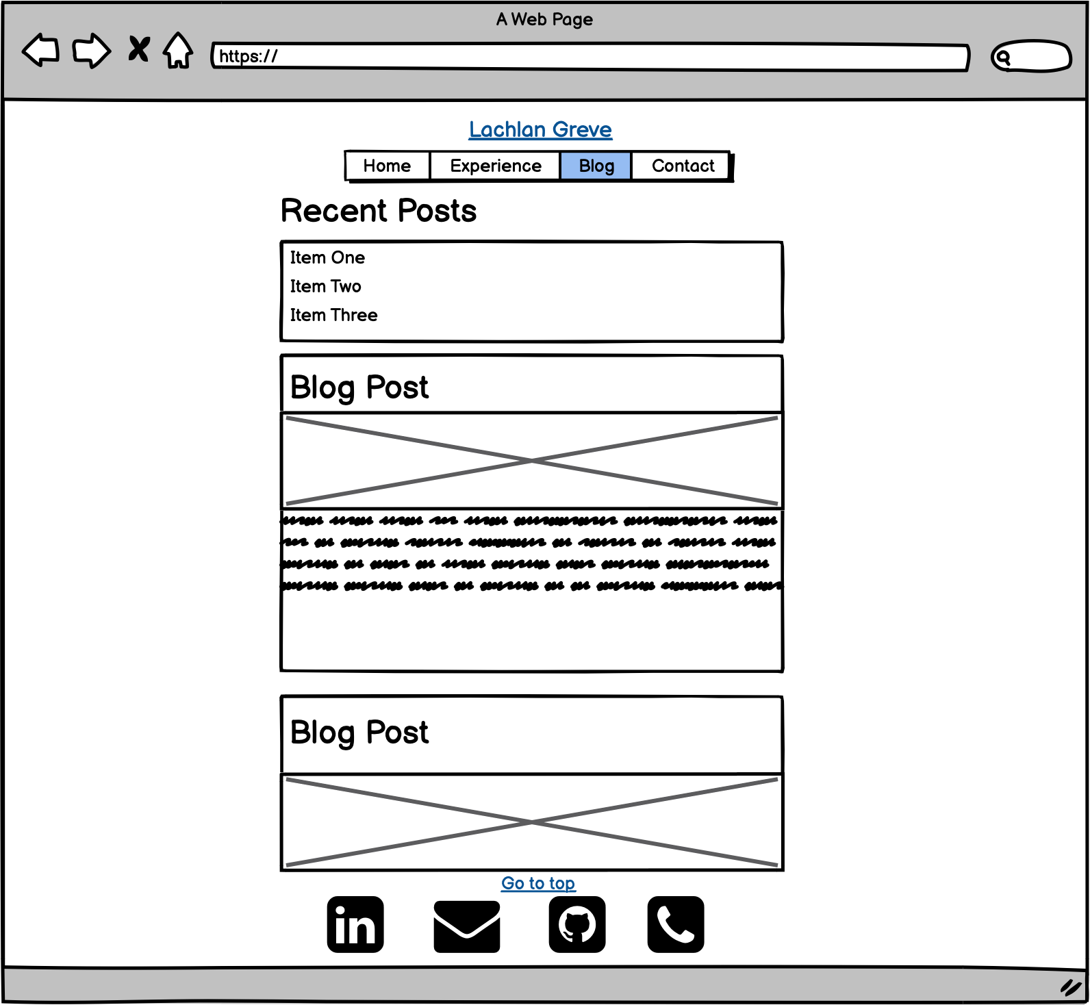
BLOG PAGE - WIREFRAMING
Audience Engagement:
Recent post list at top of page with anchors to specific posts
Blog posts are segmented with a separate style ‘card’
Back to top link
Page margin that adjusts to the width of the screen
Development & Build Process

Slide 22
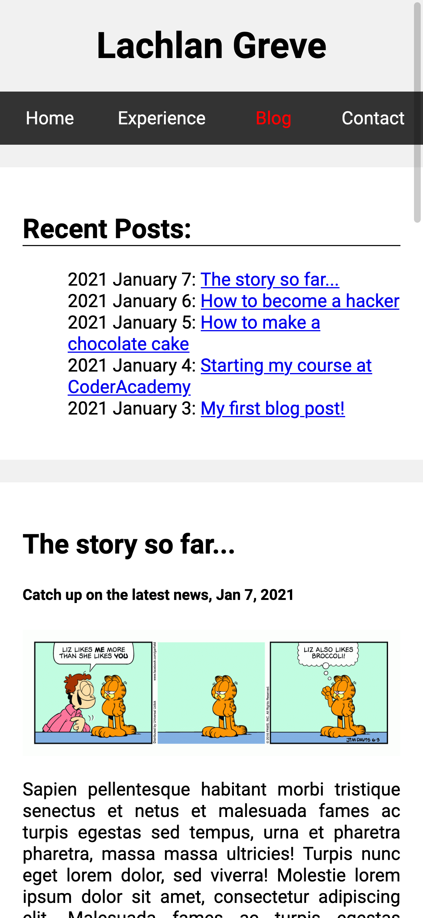
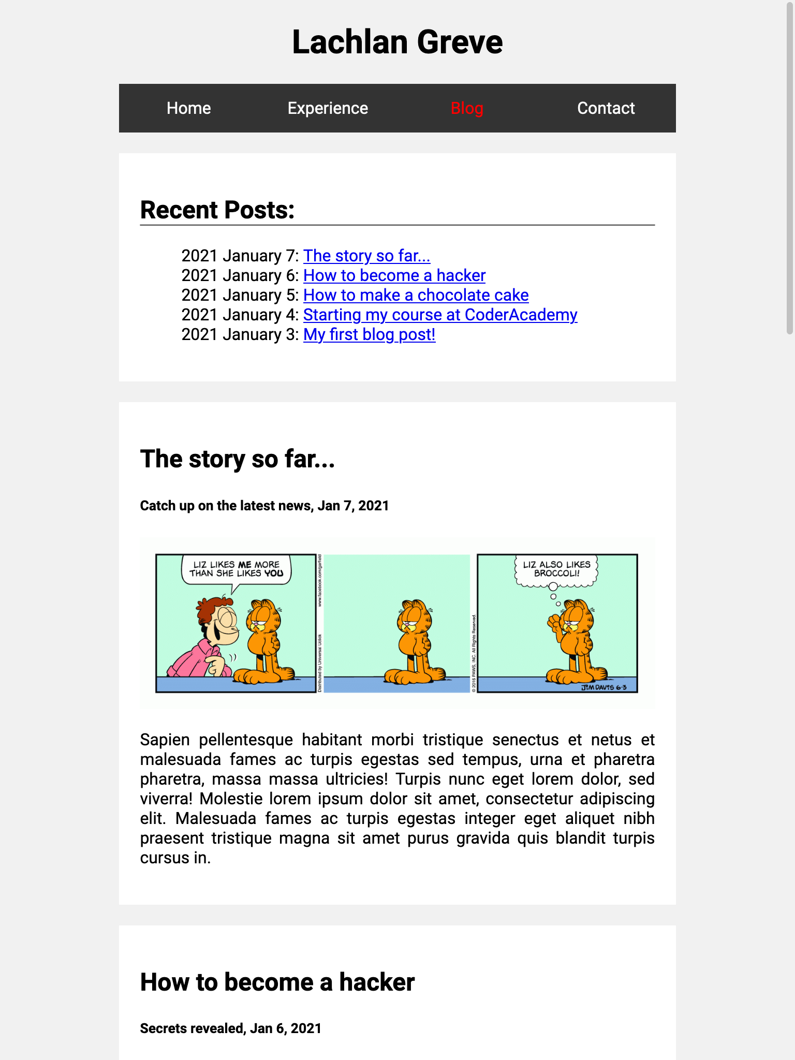
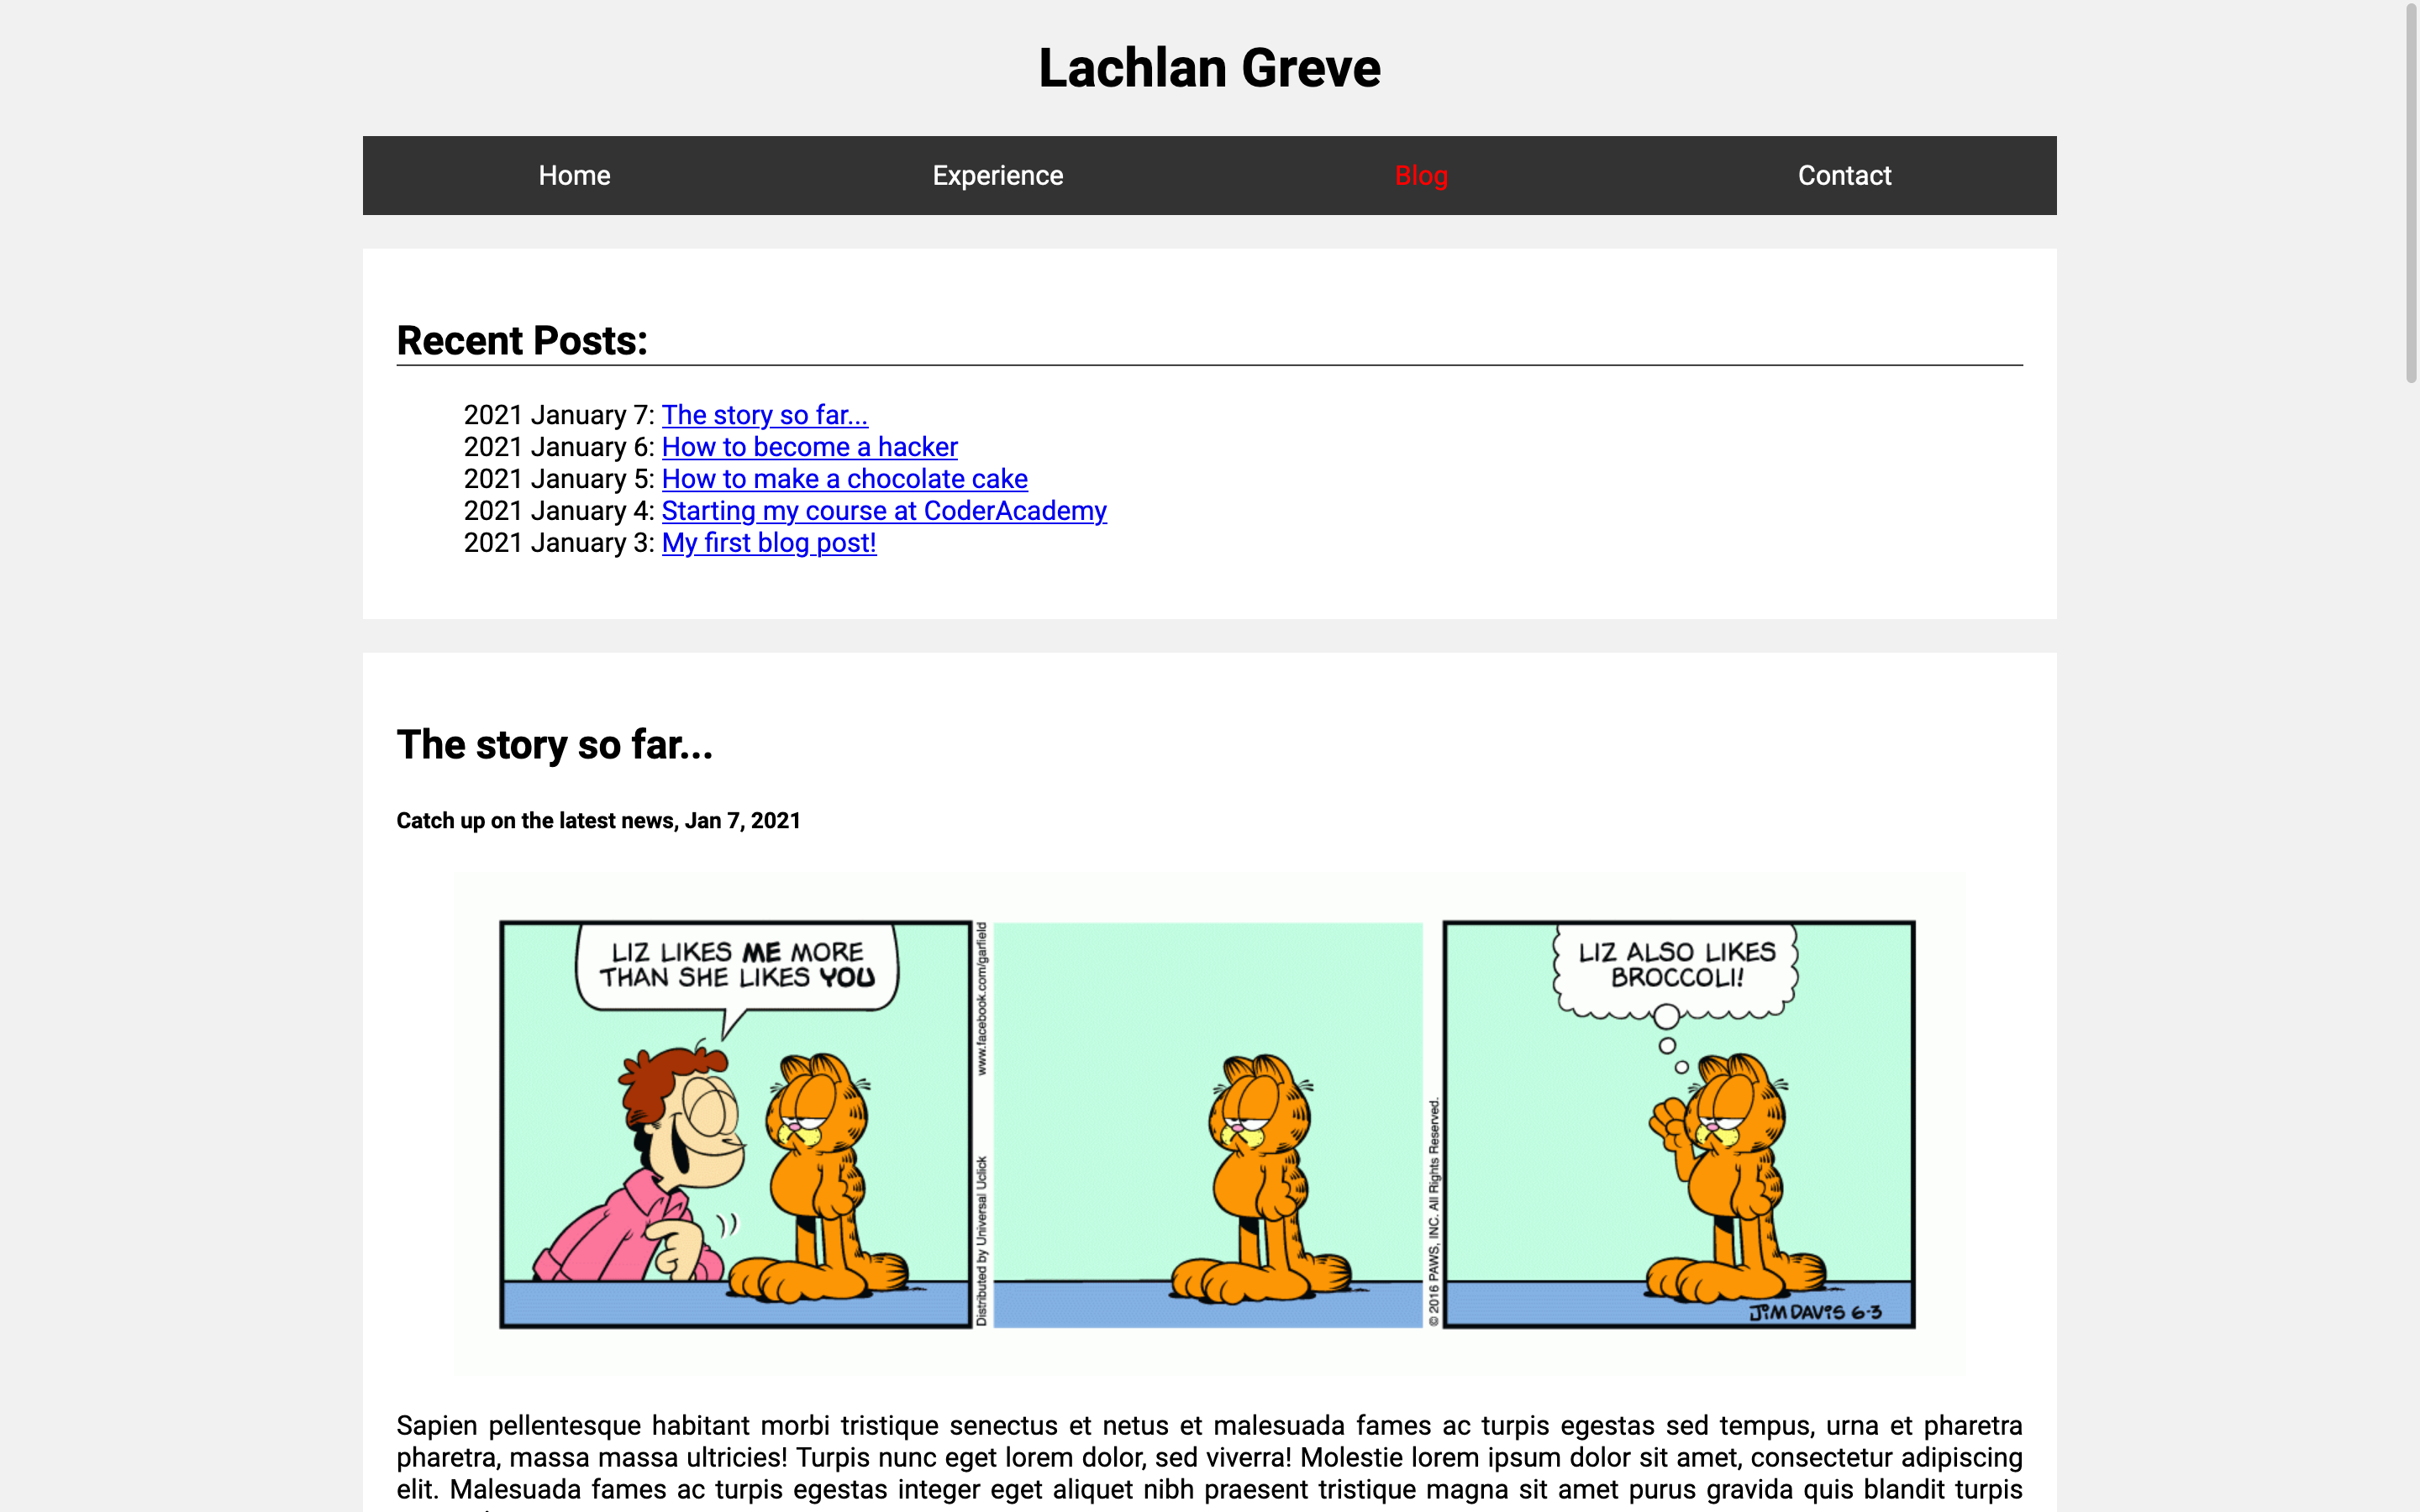
BLOG PAGE - FINAL DESIGN
Development & Build Process

Slide 23
CONTACT PAGE - DESIGN
This page will contain:
A link to my Github and LinkedIn Accounts
A mailto anchor linked to my email address
My phone number
Clickable icons that link to their respective content
Development & Build Process

Slide 24
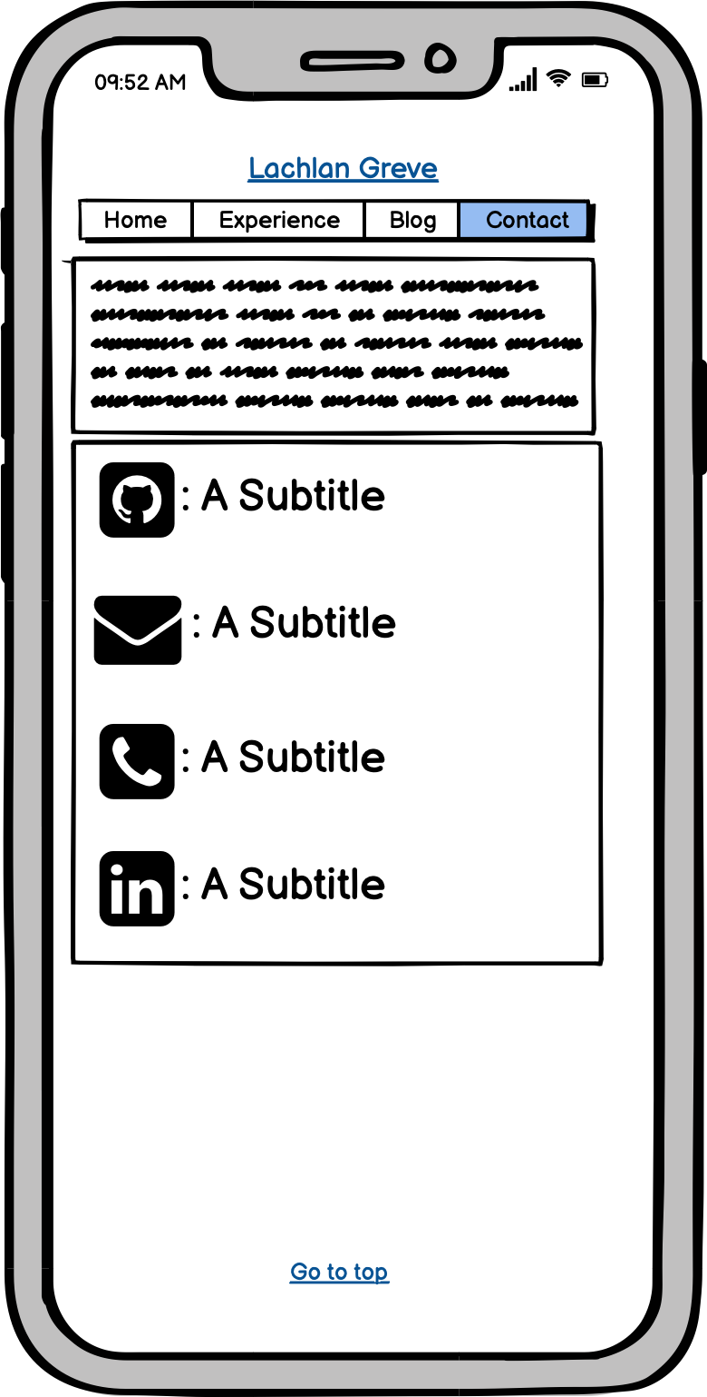
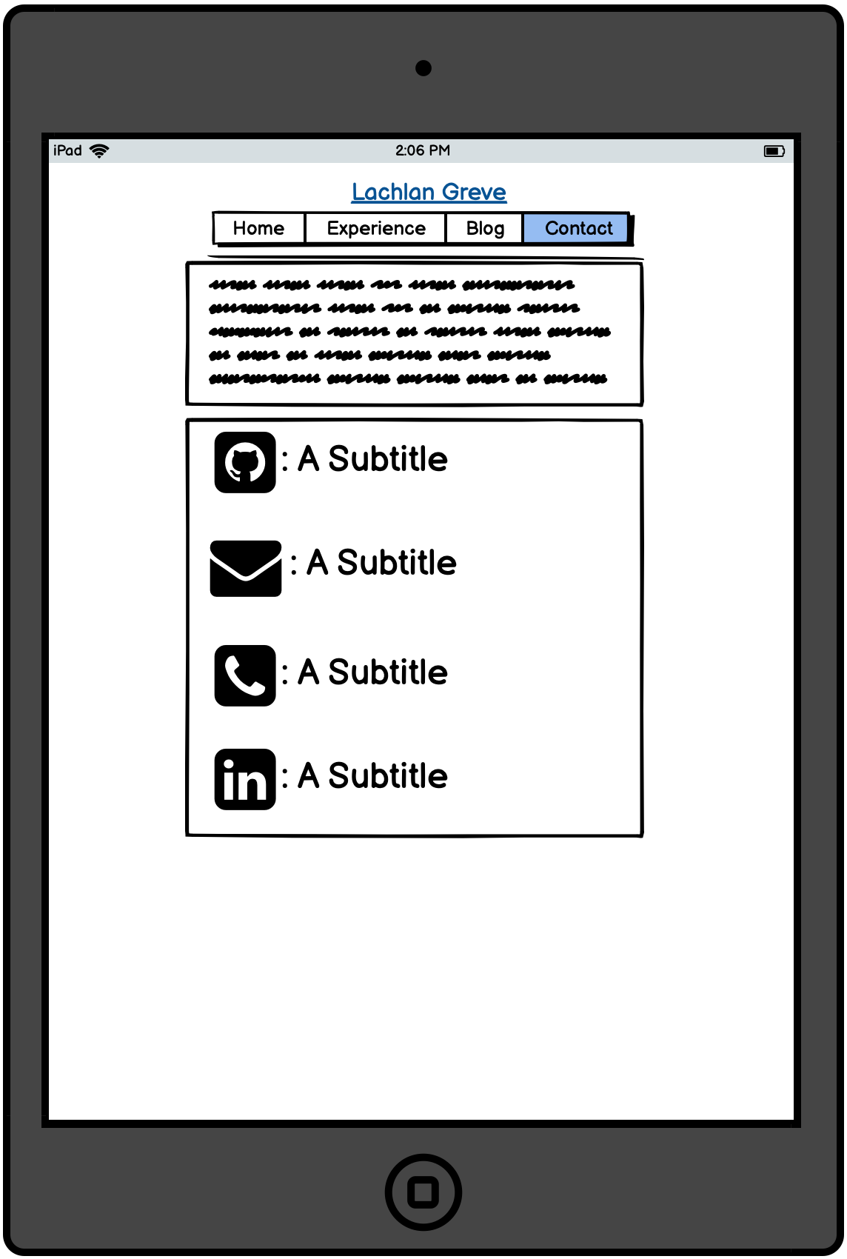
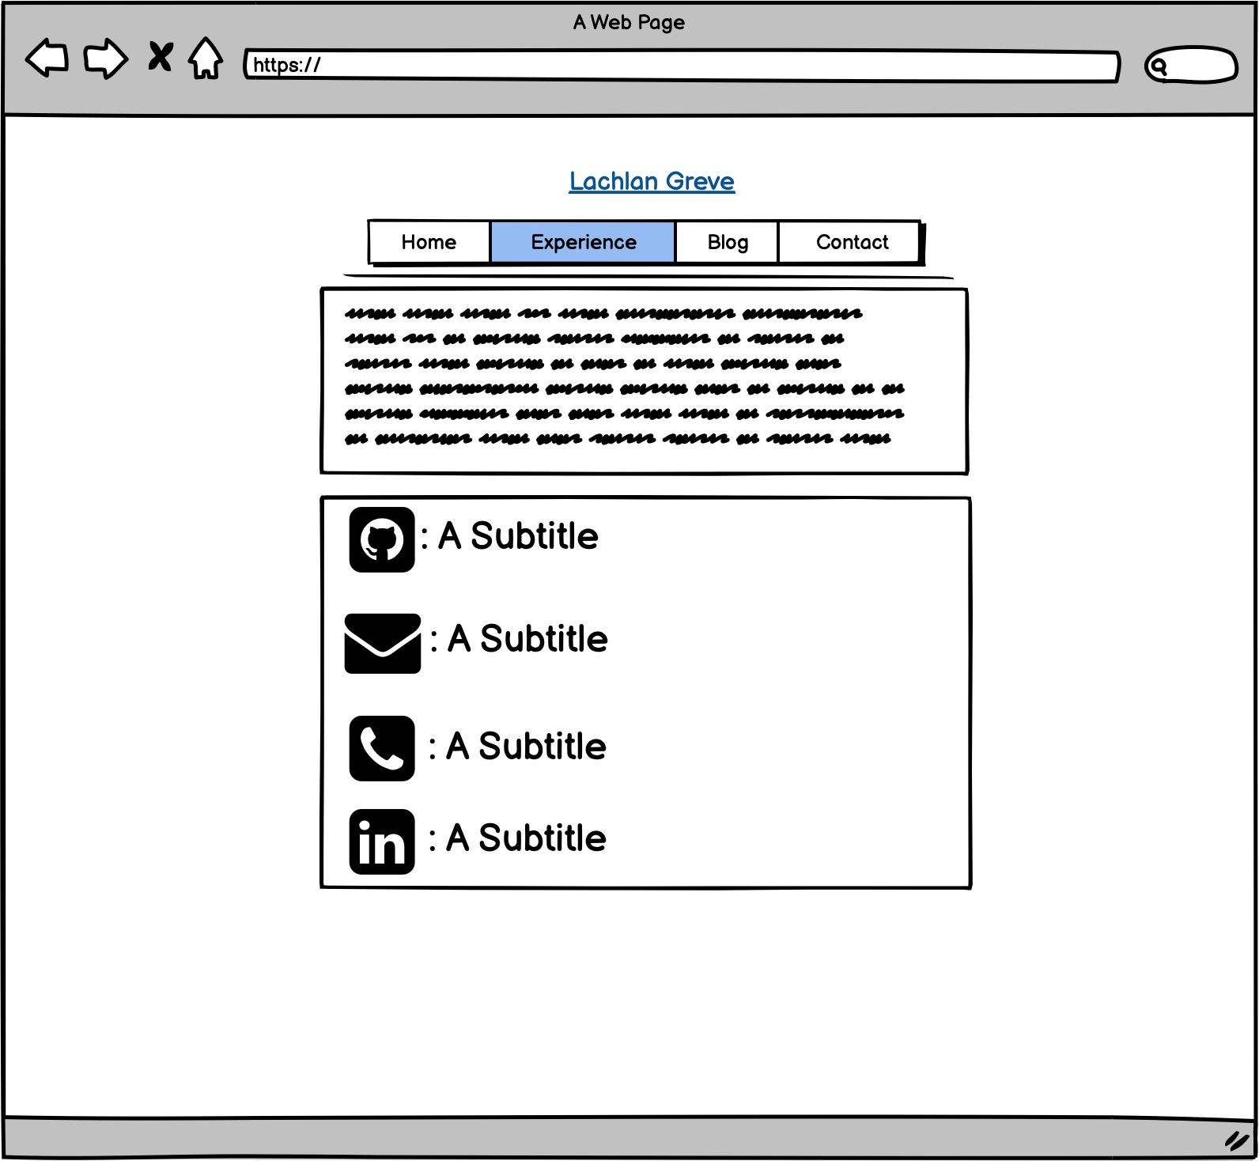
CONTACT PAGE - WIREFRAMING
Audience Engagement:
Semantic links to phone number, email, github and linkedin
Footer repositioned as a central component of content
Margins respond to width of screen
Nav bar hover effect and highlight of current selection
Development & Build Process

Slide 25
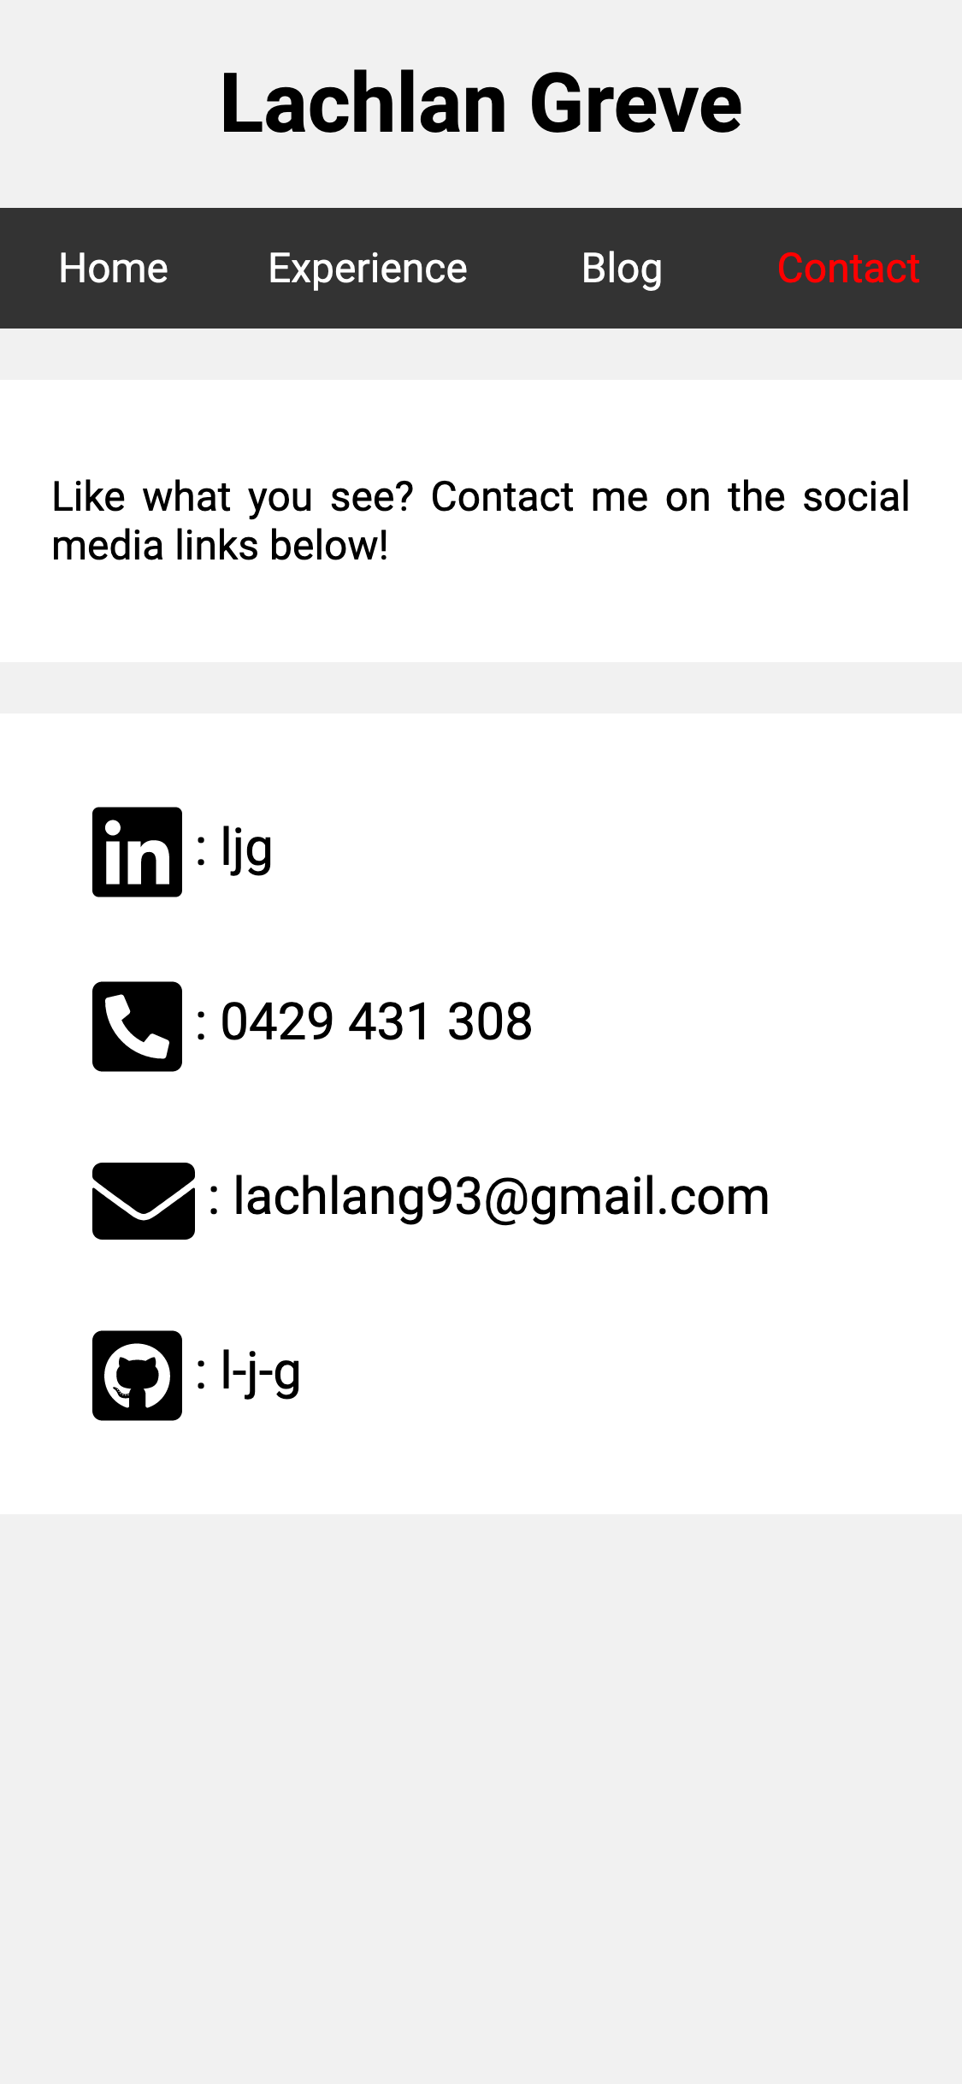
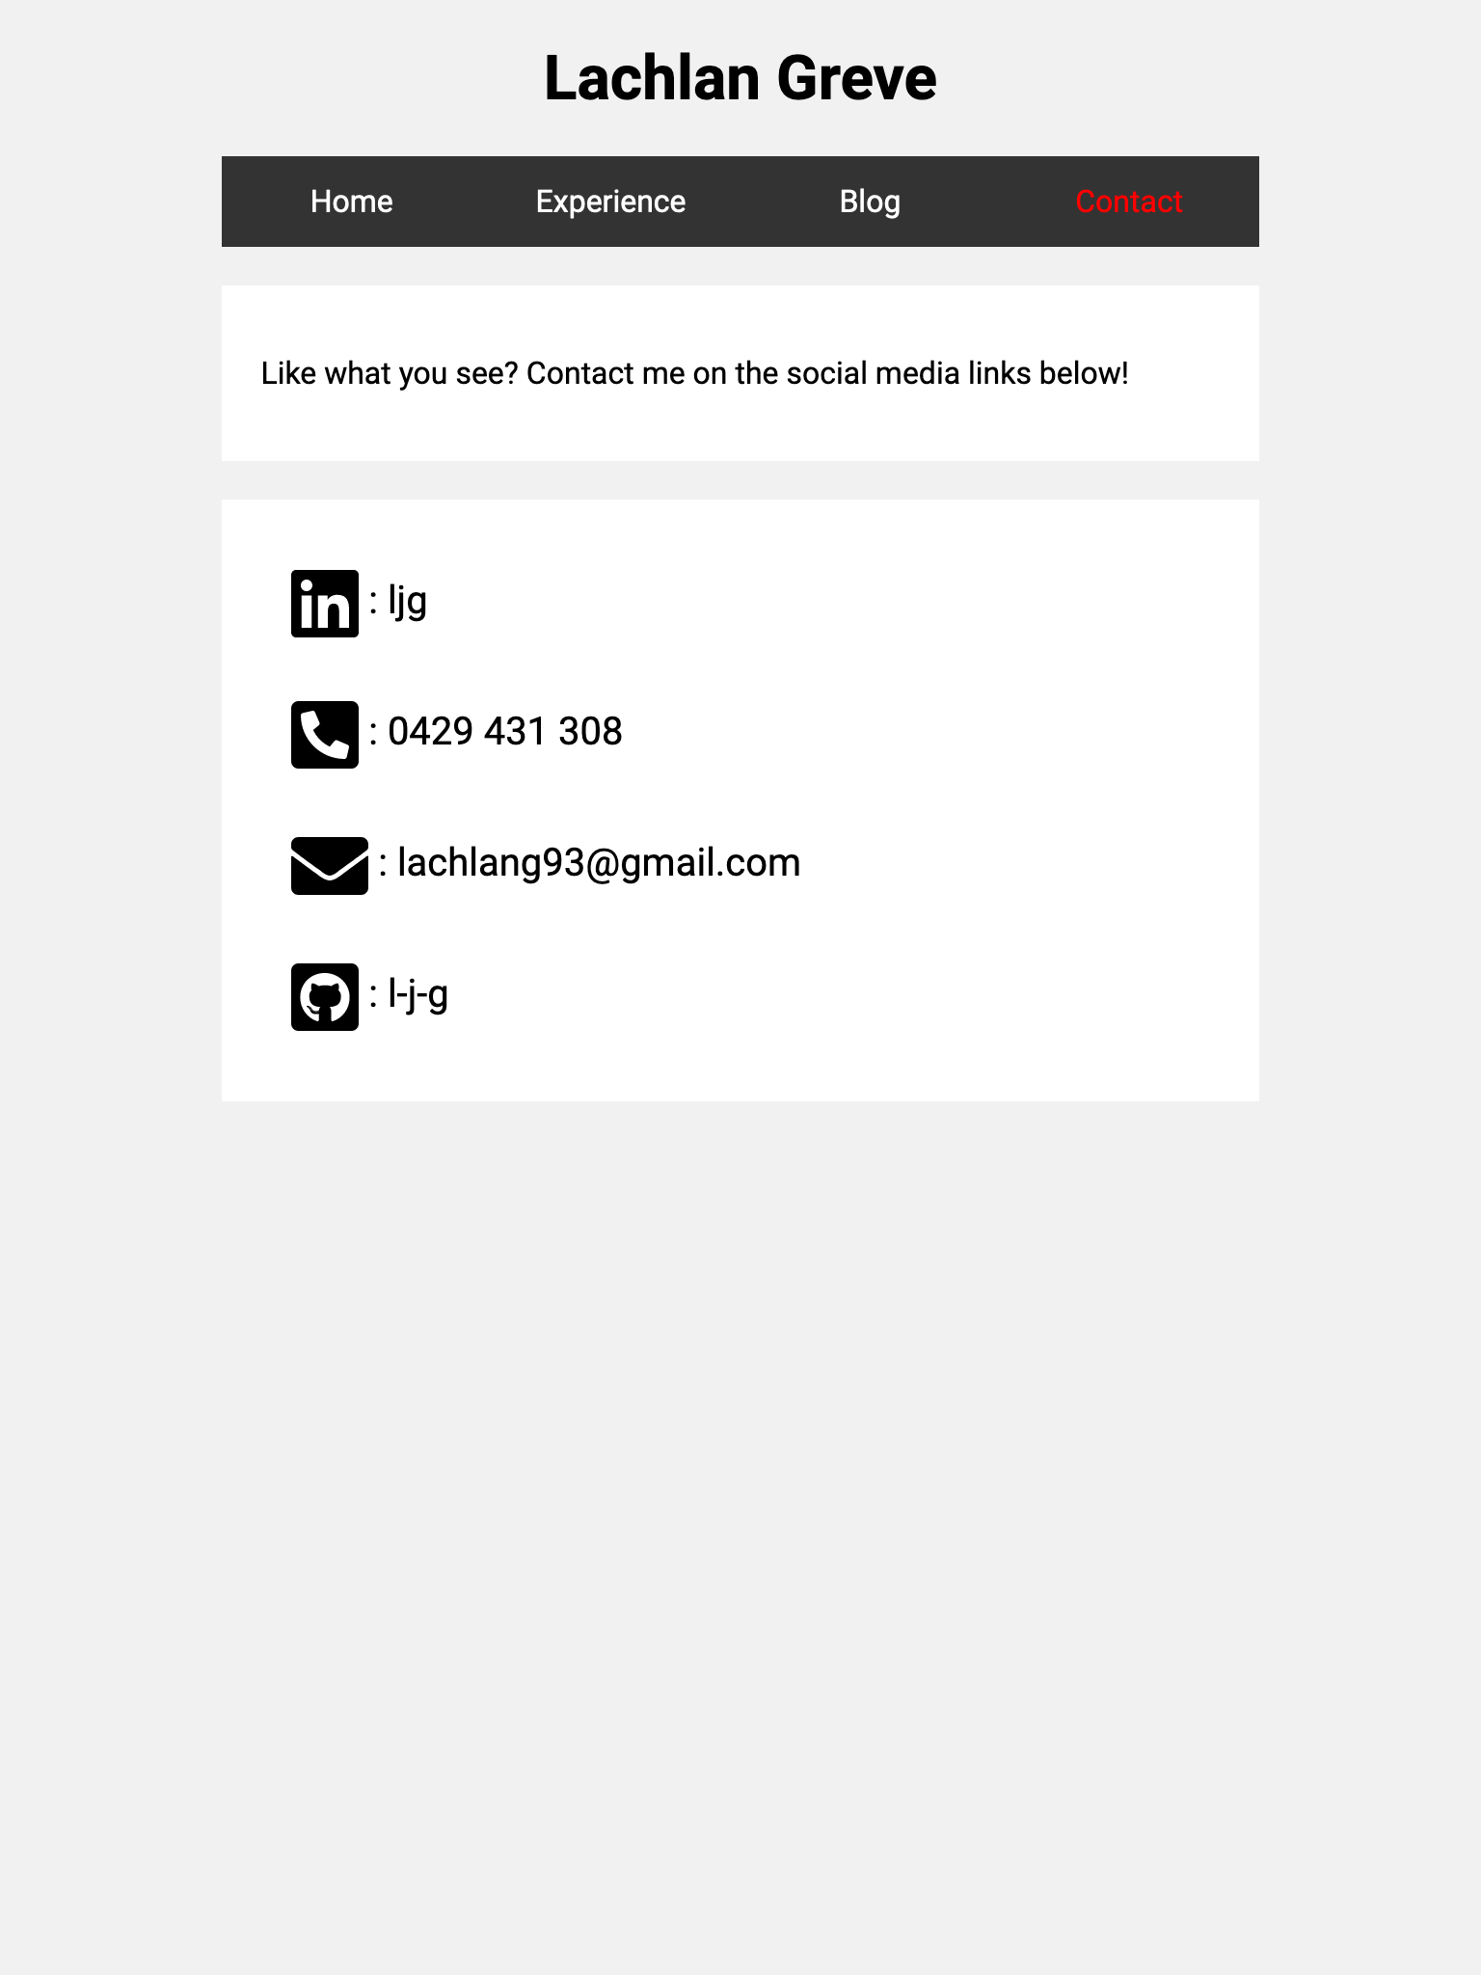
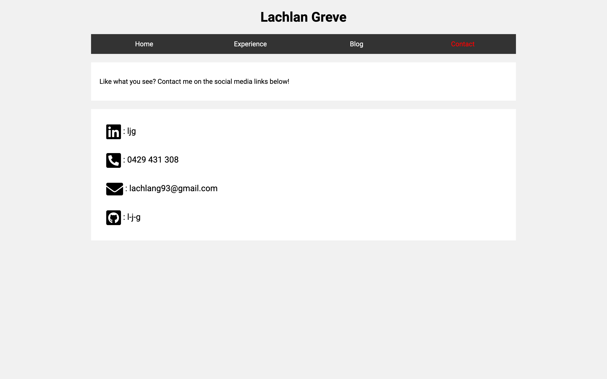
CONTACT PAGE - FINAL DESIGN
Development & Build Process

Slide 26
Challenges
First time using HTML or CSS – Needed to research and learn as I develop the portfolio
Debugging – Figuring out why things don’t work the way I wanted them too
Semantic and responsive design to make the page as accessible as possible
Source Control – maintaining a log of commits and backup points
Development & Build Process

Slide 27
ETHICAL ISSUES
Semantic HTML - Additional work with limited return for most users
Not knowing how to implement some features that I wanted to and developing original content with wide availability of tutorials and automation tools available.
Example: Experience Page
I took inspiration from online tutorials and walkthroughs that were available publicly
Took time to understand each step of the design and to implement it in my own way
Development & Build Process

Slide 28
FAVOURITE PARTS
Problem Solving and Debugging - Figuring out how to get things to display the way I want them to
A tangible outcome – Having a platform and portfolio that I use in the future to refer potential employers to
Self paced work – Having the freedom the design my portfolio in my own way to reflect my skills and preferences
Development & Build Process

